Slide 1
Q1. An RC coupled amplifier has a voltage gain of 1000, f₁ = 50 Hz, f₂ = 200 kHz, and a distortion of 5%, without feedback. Find the amplifier voltage gain, f_{1f}, f_{2f}, and distortion (D_{f}) when a negative feedback is applied with feedback ratio of 0.01.

Slide 2
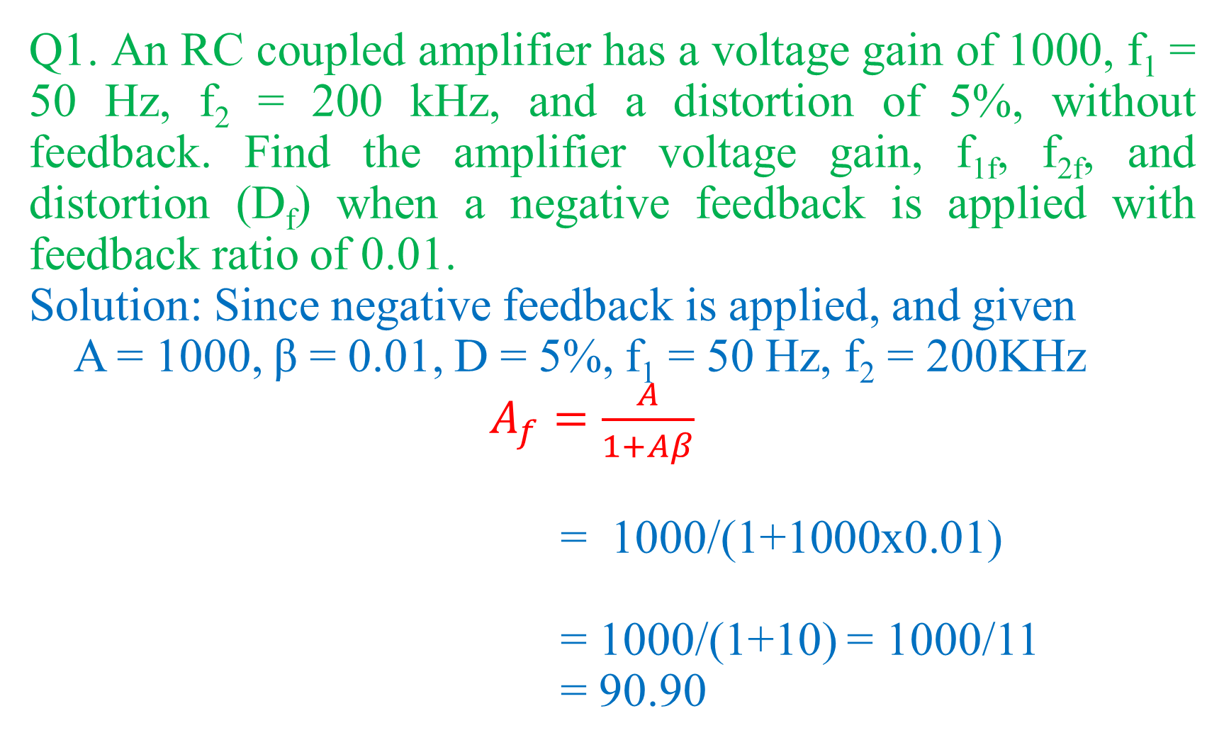
Q1. An RC coupled amplifier has a voltage gain of 1000, f₁ = 50 Hz, f₂ = 200 kHz, and a distortion of 5%, without feedback. Find the amplifier voltage gain, f_{1f}, f_{2f}, and distortion (D_{f}) when a negative feedback is applied with feedback ratio of 0.01.
Solution: Since negative feedback is applied, and given
A = 1000, β = 0.01, D = 5%, f₁ = 50 Hz, f₂ = 200KHz
$A_{f}=\frac{A}{1+Aβ}$
= 1000/(1+1000x0.01)
= 1000/(1+10) = 1000/11
= 90.90

Slide 3
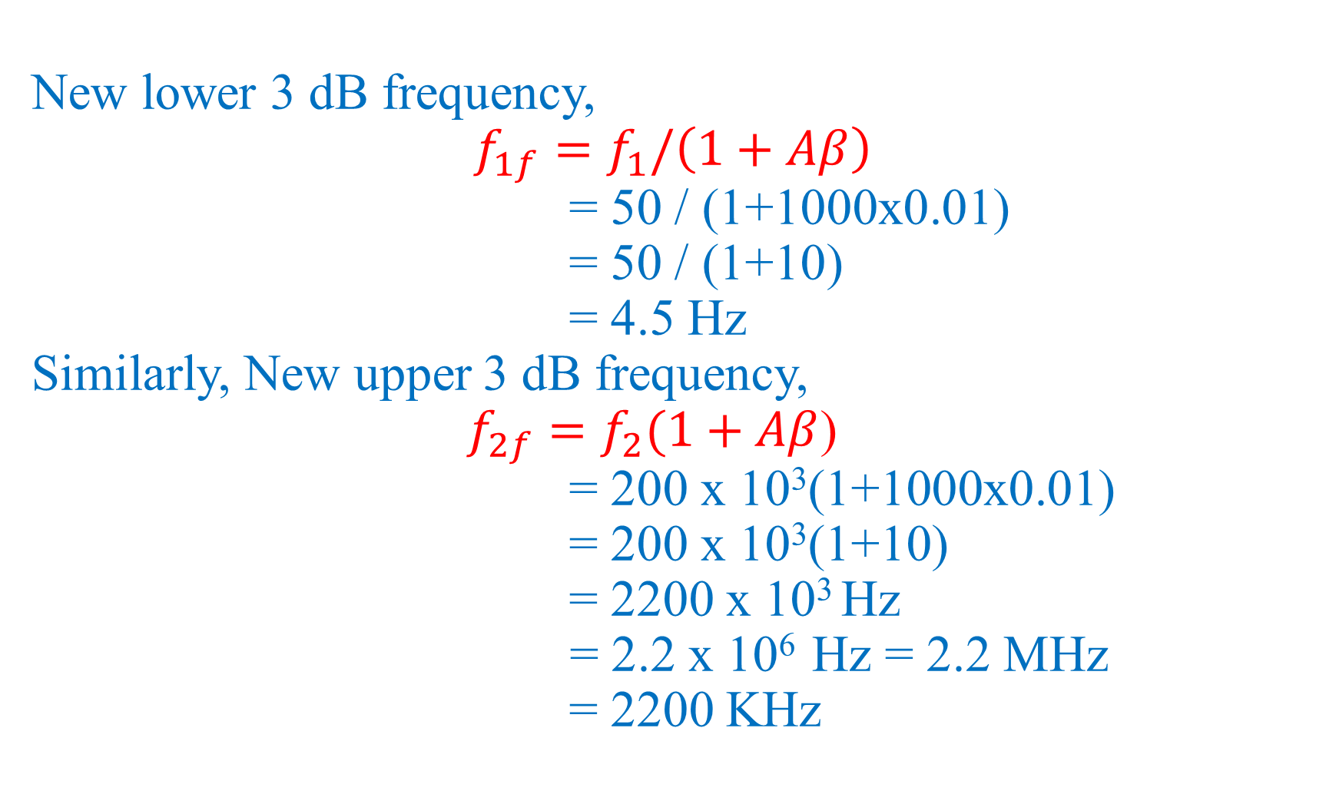
New lower 3 dB frequency,
$$f_{1f}=f_{1}/\left(1+Aβ\right)$$
= 50 / (1+1000x0.01)
= 50 / (1+10)
= 4.5 Hz
Similarly, New upper 3 dB frequency,
$f_{2f}=f_{2}(1+Aβ$)
= 200 x 10³(1+1000x0.01)
= 200 x 10³(1+10)
= 2200 x 10³ Hz
= 2.2 x 10⁶ Hz = 2.2 MHz
= 2200 KHz

Slide 4
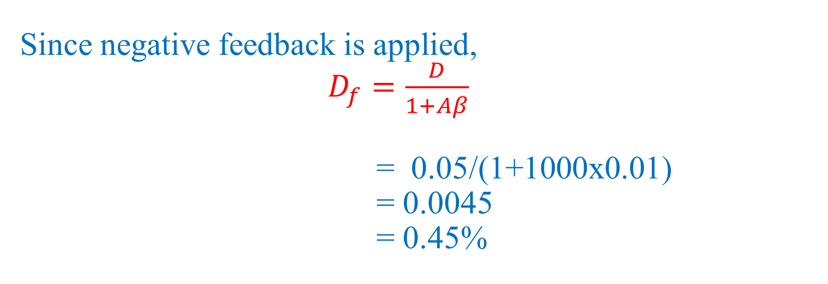
Since negative feedback is applied,
$D_{f}=\frac{D}{1+Aβ}$
= 0.05/(1+1000x0.01)
= 0.0045
= 0.45%

Slide 5
Q2. The open-loop voltage gain of an amplifier is 50. Its input impedance is 1 kΩ. What will be the input impedance where a negative feedback of 10% is applied to the amplifier?

Slide 6
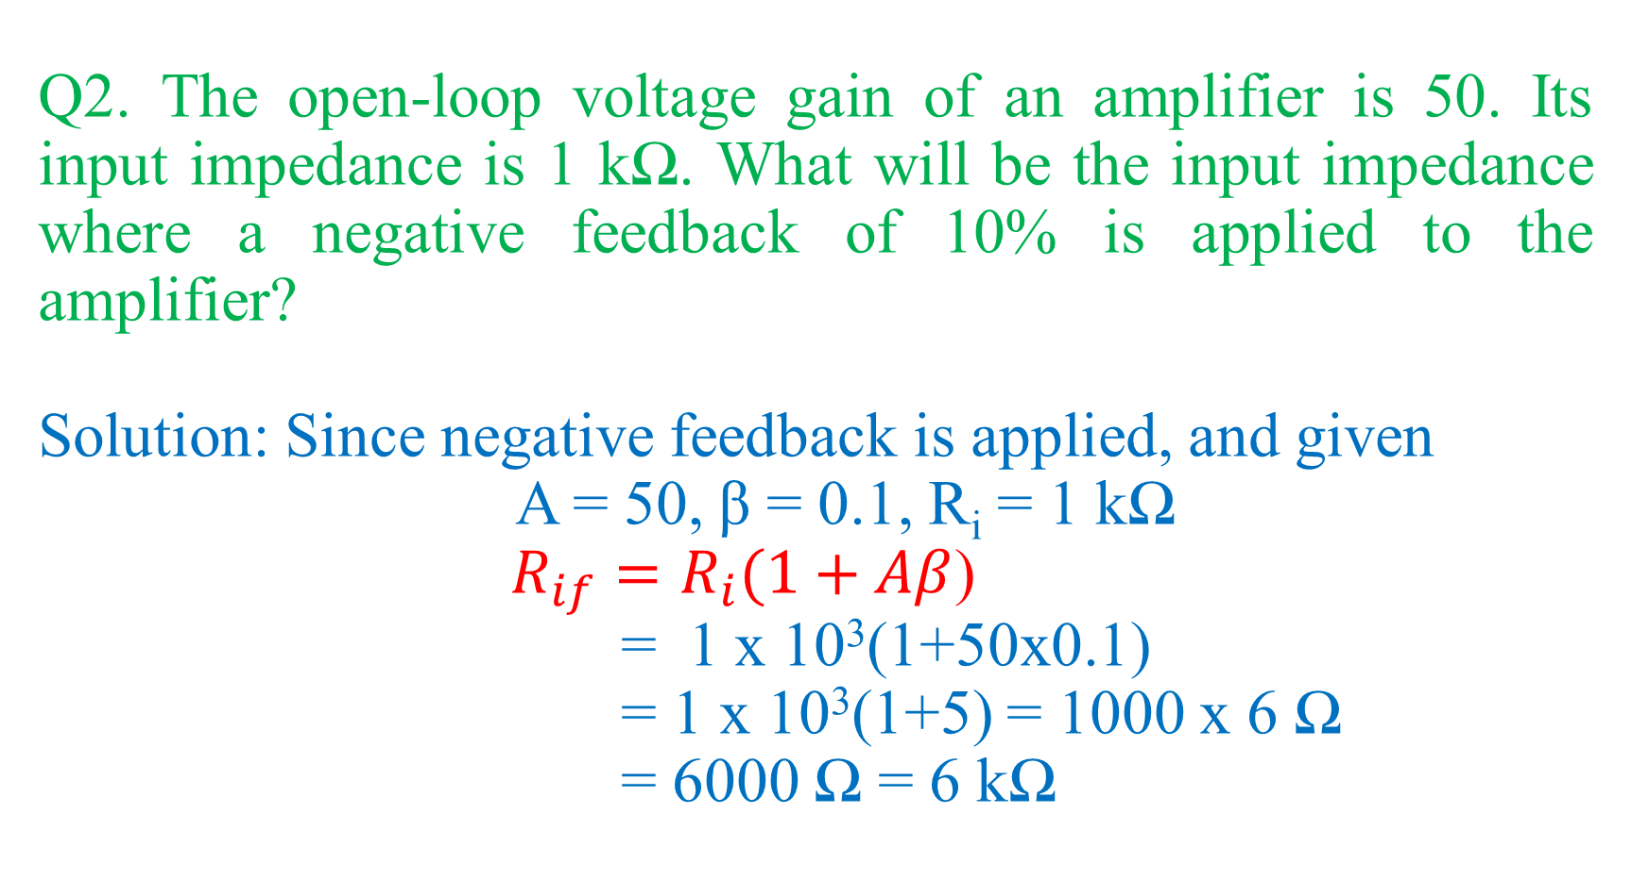
Q2. The open-loop voltage gain of an amplifier is 50. Its input impedance is 1 kΩ. What will be the input impedance where a negative feedback of 10% is applied to the amplifier?
Solution: Since negative feedback is applied, and given
A = 50, β = 0.1, R_{i} = 1 kΩ
$R_{if}=R_{i}(1+Aβ$)
= 1 x 10³(1+50x0.1)
= 1 x 10³(1+5) = 1000 x 6 Ω
= 6000 Ω = 6 kΩ

Slide 7
Q3. The open-loop voltage gain of an amplifier is 50. Its output impedance is 40 kΩ. When a negative feedback is applied, the output impedance becomes 6.666 kΩ. Find the feedback factor.

Slide 8
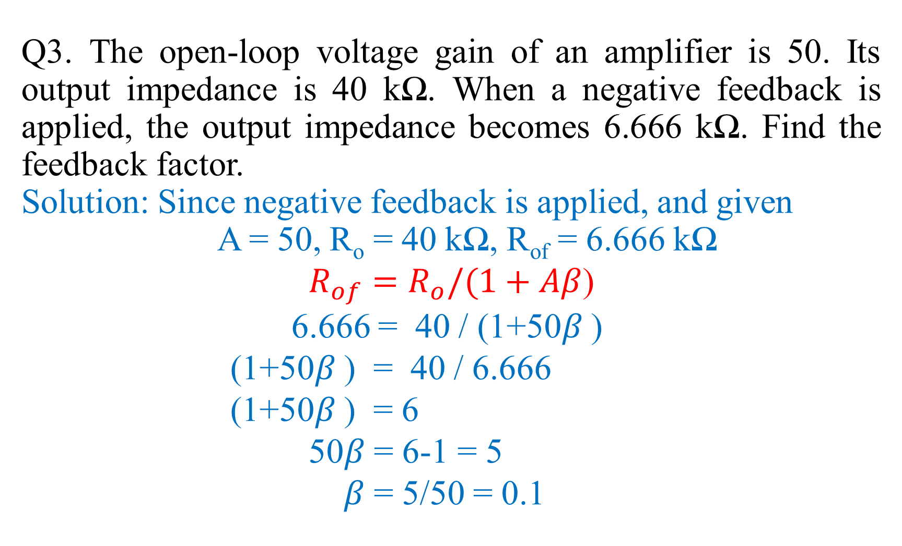
Q3. The open-loop voltage gain of an amplifier is 50. Its output impedance is 40 kΩ. When a negative feedback is applied, the output impedance becomes 6.666 kΩ. Find the feedback factor.
Solution: Since negative feedback is applied, and given
A = 50, R_{o} = 40 kΩ, R_{of} = 6.666 kΩ
$R_{of}=R_{o}/(1+Aβ$)
6.666 = 40 / (1+50$β$ )
(1+50$β$ ) = 40 / 6.666
(1+50$β$ ) = 6
50$β$ = 6-1 = 5
$β$ = 5/50 = 0.1

Slide 9
Q4. The distortion in an amplifier is found to be 3% when the feedback ratio of a negative feedback amplifier is 0.04. When the feedback is removed, the distortion becomes 15%. Find the open-loop gain and closed loop gain.

Slide 10
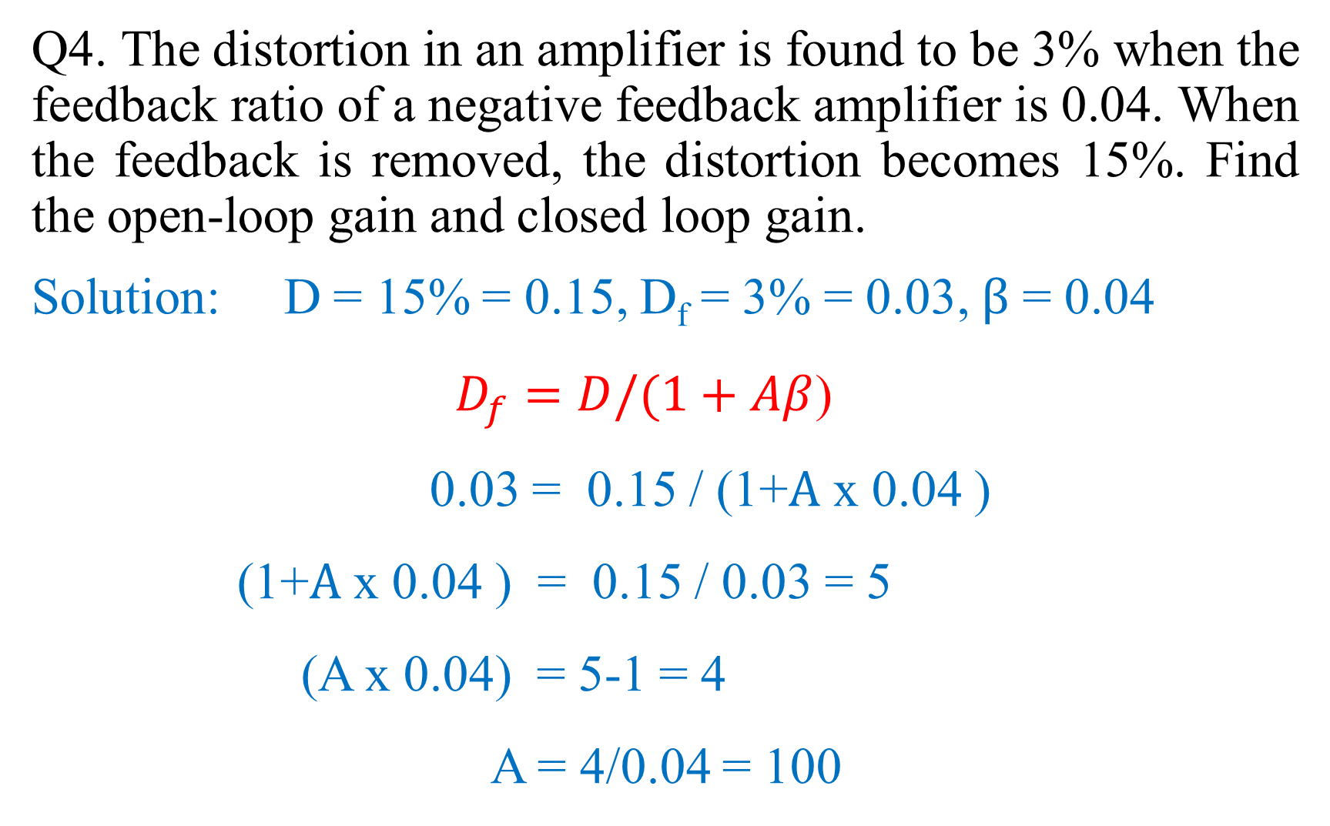
Q4. The distortion in an amplifier is found to be 3% when the feedback ratio of a negative feedback amplifier is 0.04. When the feedback is removed, the distortion becomes 15%. Find the open-loop gain and closed loop gain.
Solution: D = 15% = 0.15, D_{f} = 3% = 0.03, $β$ = 0.04
$D_{f}=D/(1+Aβ$)
0.03 = 0.15 / (1+$A$ x 0.04 )
(1+$A$ x 0.04 ) = 0.15 / 0.03 = 5
(A x 0.04) = 5-1 = 4
A = 4/0.04 = 100

Slide 11

$A_{f}=\frac{A}{1+Aβ}$
= 100 / (1 + 100 x 0.04)
= 100 / 1+4
= 100 /5 = 20

Slide 12
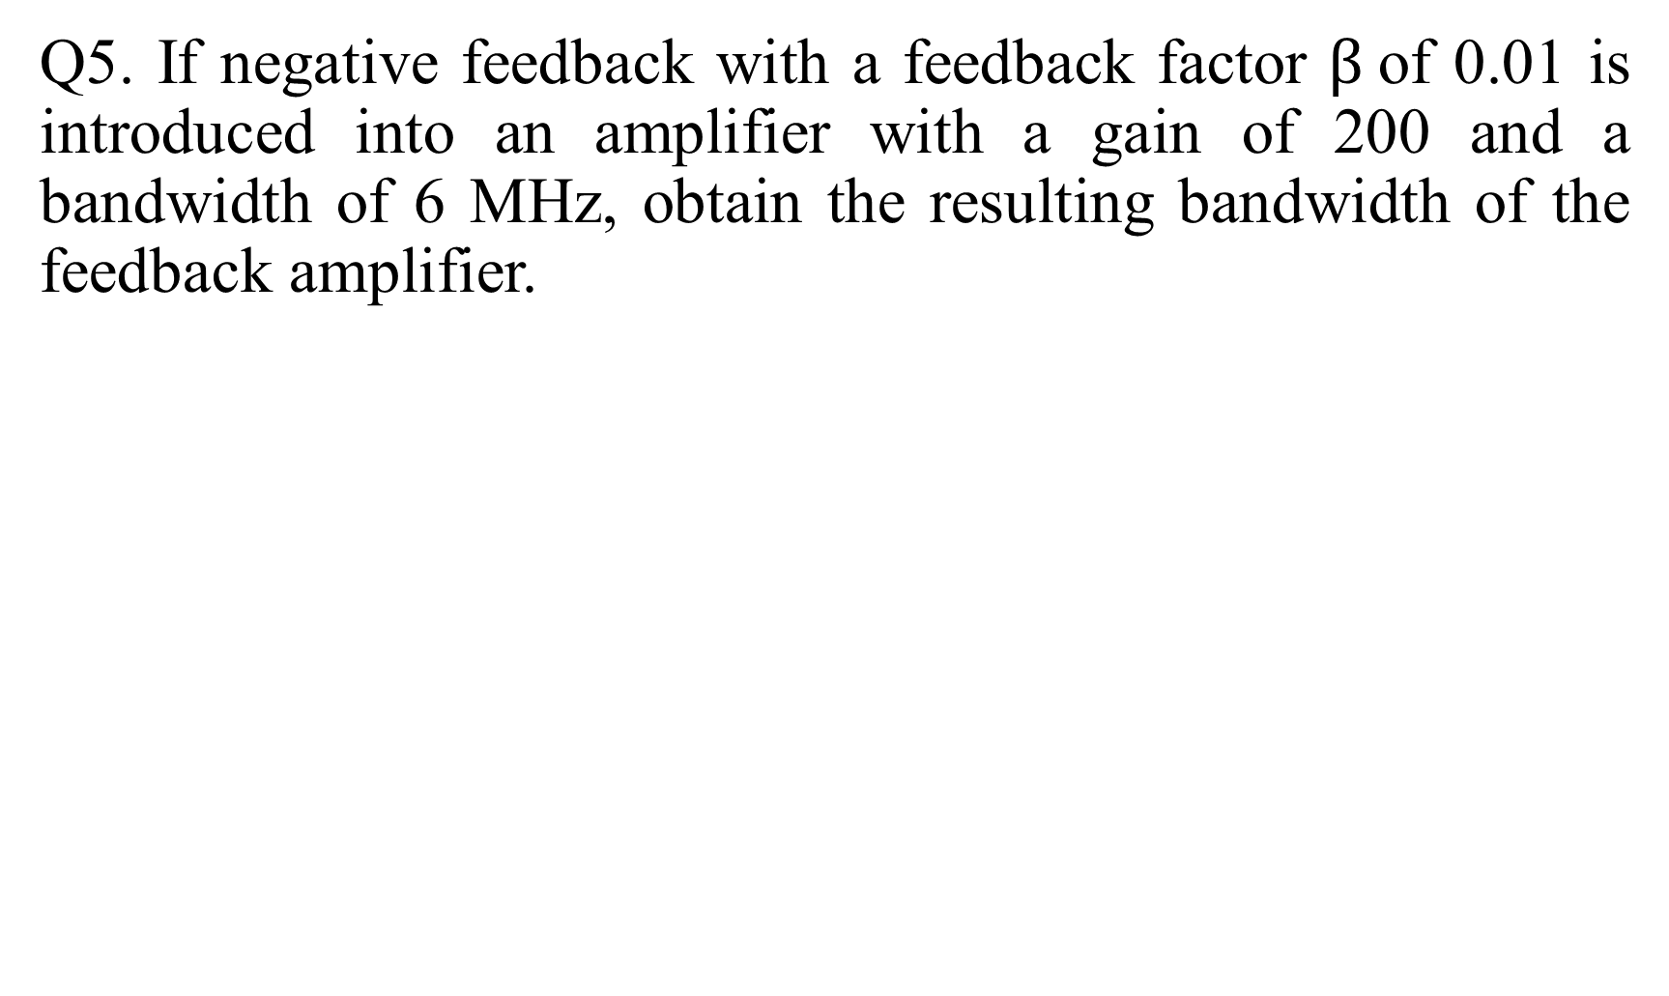
Q5. If negative feedback with a feedback factor $β$of 0.01 is introduced into an amplifier with a gain of 200 and a bandwidth of 6 MHz, obtain the resulting bandwidth of the feedback amplifier.

Slide 13
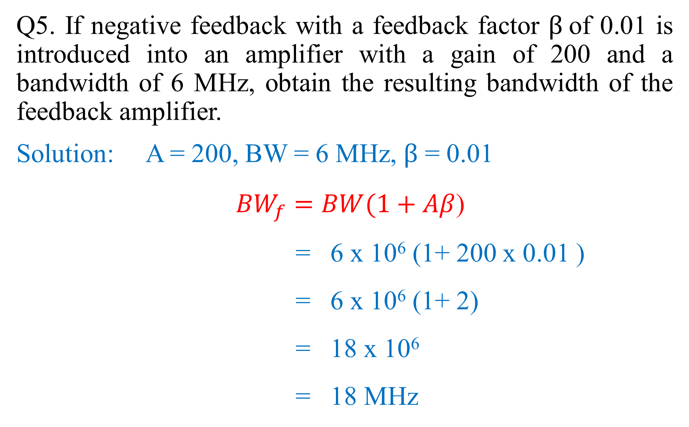
Q5. If negative feedback with a feedback factor $β$of 0.01 is introduced into an amplifier with a gain of 200 and a bandwidth of 6 MHz, obtain the resulting bandwidth of the feedback amplifier.
Solution: A = 200, BW = 6 MHz, $β$ = 0.01
${BW}_{f}=BW(1+Aβ$)
= 6 x 10⁶ (1+ 200 x 0.01 )
= 6 x 10⁶ (1+ 2)
= 18 x 10⁶
= 18 MHz

Slide 14

Q6. If non linear distortion in a negative feedback amplifier with an open-loop gain of 100 is reduced from 40% to 10%. Find the $β$of the amplifier.

Slide 15
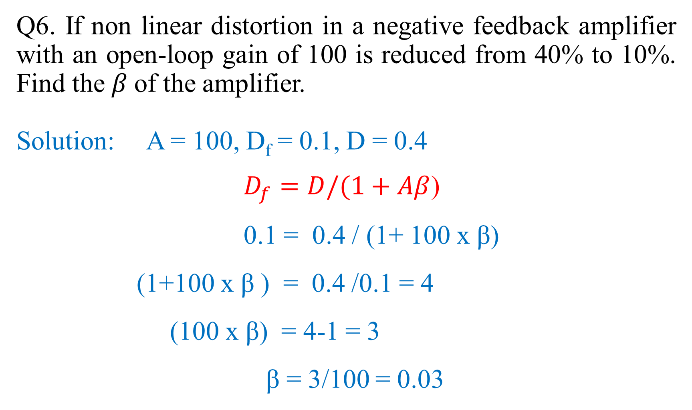
Q6. If non linear distortion in a negative feedback amplifier with an open-loop gain of 100 is reduced from 40% to 10%. Find the $β$of the amplifier.
Solution: A = 100, D_{f} = 0.1, D = 0.4
$D_{f}=D/(1+Aβ$)
0.1 = 0.4 / (1+ 100 x β)
(1+100 x β ) = 0.4 /0.1 = 4
(100 x β) = 4-1 = 3
β = 3/100 = 0.03

